Slide 1
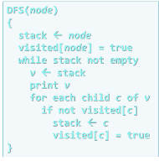
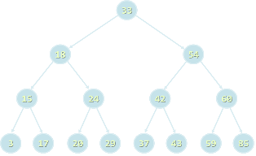

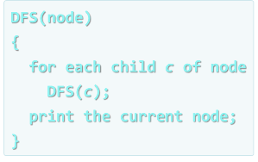


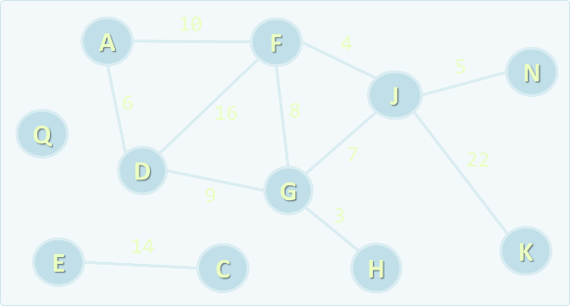
Data Structures
Curriculum, Trainers, Evaluation, Exams
Data
Structures
SoftUni Team
Technical Trainers
Software University
http://softuni.bg

Slide 2

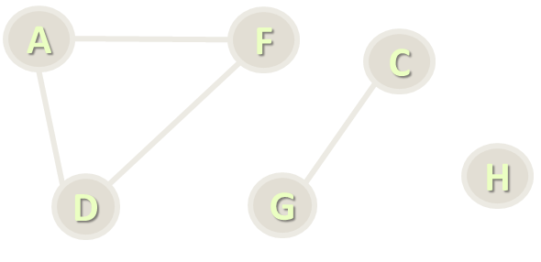
Table of Contents
Course Objectives
Course Program
Trainers Team
Examination
Learning Resources

Slide 3

Data Structures
Course Objectives & Program

Slide 4
Part I: Data Structures – Course Program
Course Overview
Data Structures, Algorithms and Complexity
Linear Data Structures – Lists
Linear Data Structures – Stacks and Queues
Trees and Tree-Like Structures
Tree Traversal Algorithms – BFS and DFS
Dictionaries and Hash Tables

Slide 5
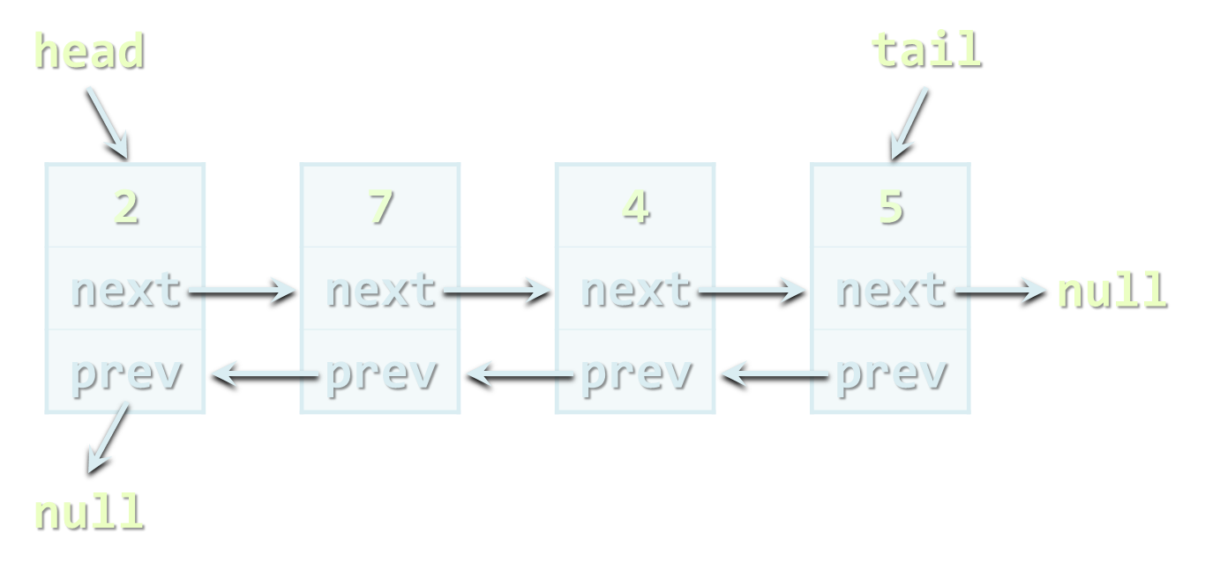
Part I: Data Structures – Course Program (2)
Advanced Data Structures
Advanced Tree Structures
Data Structure Efficiency
Exam Preparation
Practical Exam

Slide 6

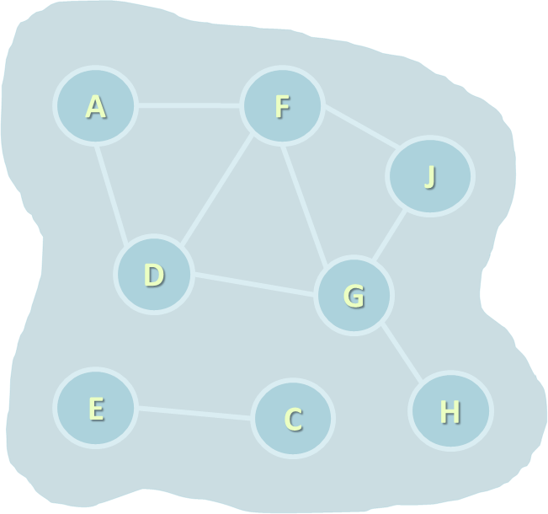
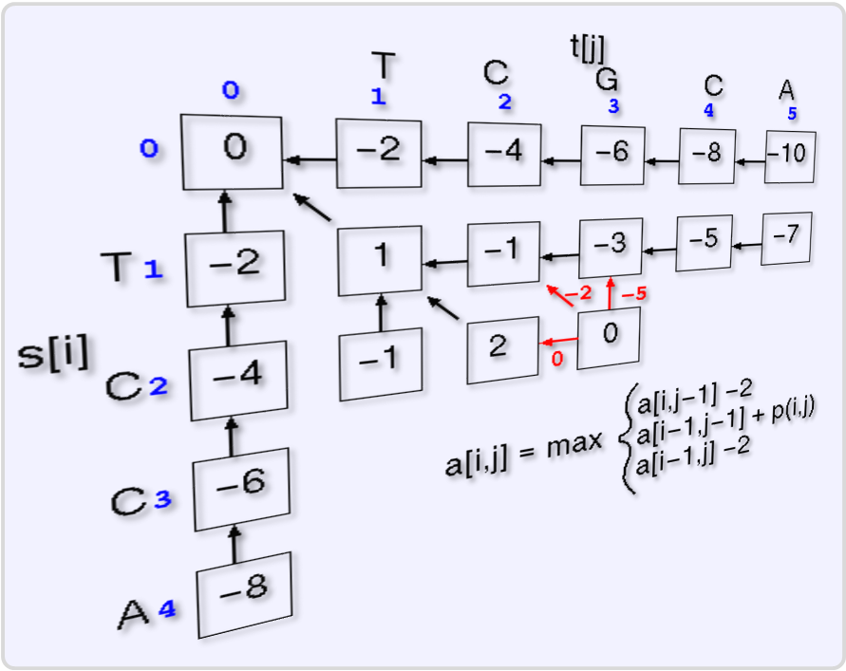
Part II: Algorithms – Course Program
Recursion and Recursive Algorithms
Combinatorial Algorithms
Sorting and Searching Algorithms
Dynamic Programming
Graphs and Graph Algorithms
Parallel Processing and Map-Reduce
Problem Solving Methodology
Exam Preparation
Practical Exam

Slide 7
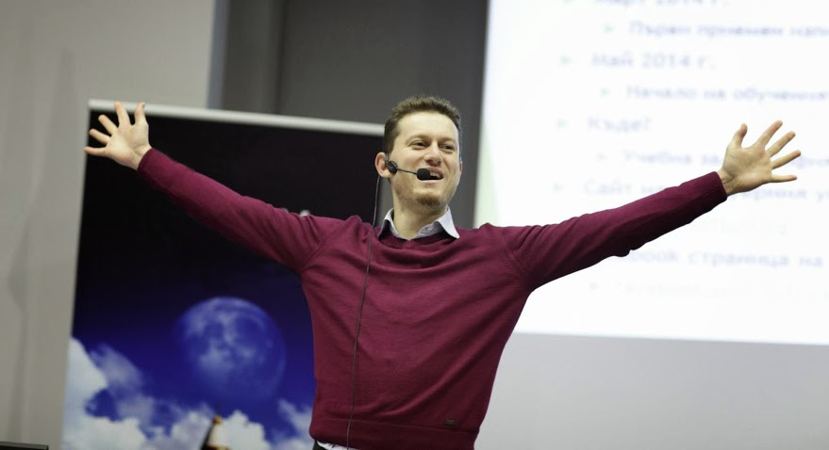
The Trainers Team

Slide 8
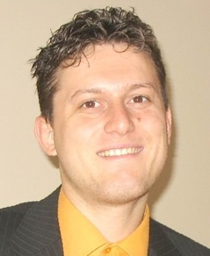
Trainers Team
Svetlin Nakov, PhD
Training & Inspiration Manager @ Software University
20+ years software development experience
10+ years experience as trainer
Author of 7 programming books
Winner in International programming contests and Olympiads
Speaker at hundreds of events
Web site & blog: www.nakov.com

Slide 9
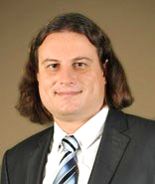
Trainers Team (2)
Preslav Nakov, PhD
Co-author of the Bulgarian algorithms bible "Programming = ++ Algorithms"
PhD in computational linguistics from University of California, Berkeley
Senior Scientist at the Qatar Computing Research Institute
International expert in data structures, algorithms, computational linguistics, natural language processing (NLP), lexical semantics, machine translation, Web as a corpus, bioinformatics, and BioNLP
Web site: http://people.ischool.berkeley.edu/~nakov/

Slide 10

Trainers Team (3)
Lyubomir Yanchev
Software engineer and entrepreneur
Winner in tens of programming contests, Olympiads and entrepreneurship challenges
Expert in data structures, algorithms, image processing and voice recognition
Speaker at hundred technical events
Twitter: https://twitter.com/lyanchev

Slide 11
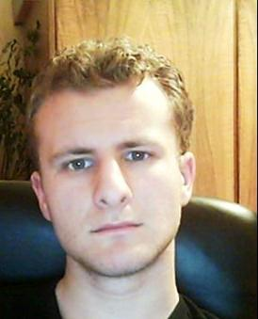
Trainers Team (4)
George Georgiev
Data structures and algorithms expert
Solid experience as technical trainer
Solid background as contestant in Informatics and IT competitions + winner many times
Graduate from the third season of Telerik Software Academy
Blog: http://itgeorge.net

Slide 12

Trainers Team (5)
Atanas Dobrev
Experienced programming contestant (and winner many times)
Strong background in data structures, algorithm design and machine learning
Worked in the Silicon Valley (in the start-up company Leanplum)
LinkedIn: https://linkedin.com/pub/atanas-dobrev/32/194/950

Slide 13
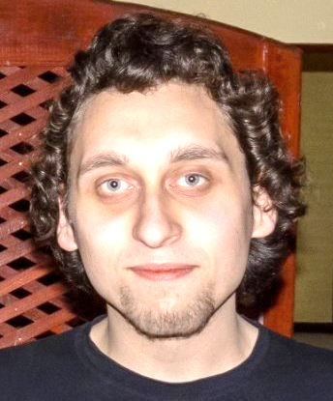
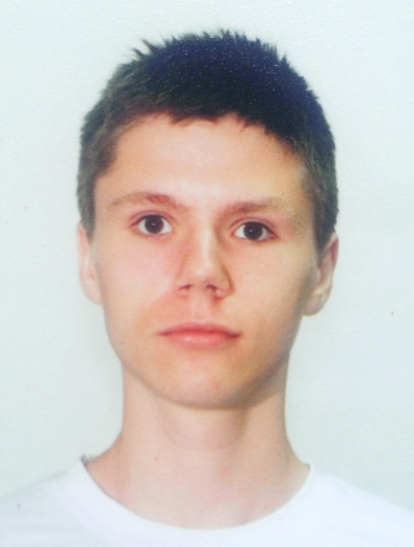
Trainers Team (6)
Yordan Darakchiev
Technical trainer @ Software University
Top performing graduate from the Telerik Software Academy (2013)
Top performing student at the Software University (2014)
Atanas Rusenov
Technical trainer @ Software University
Top performing student at the Software University (2014)

Slide 14
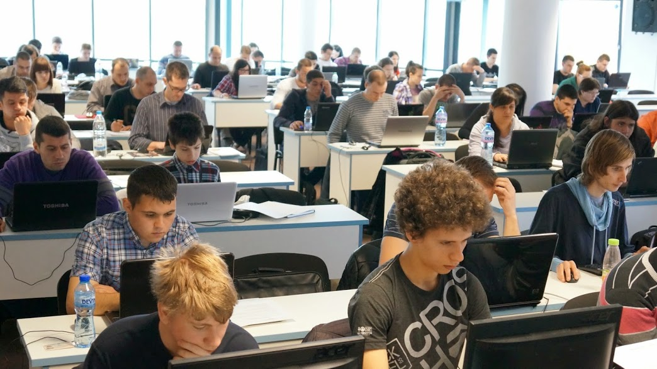
Data Structures: More Details
Duration, Course Format, Languages

Slide 15

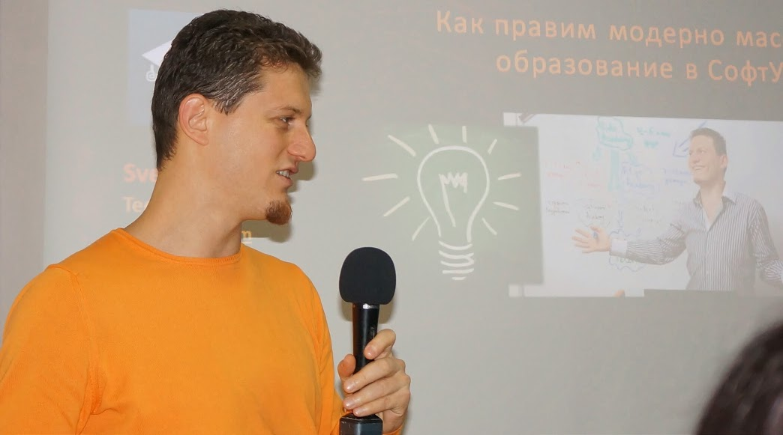
Training Duration – Data Structures
Lessons: ~ 20 hours (onsite + YouTube videos)
Practical exercises (in class): ~ 20 hours
Lab: 4 hours
Exam preparation: 4 hours
Homework: ~ 30-50 hours
Schedule: June – Sept 2015
Practical exam: 13 Sept 2015

Slide 16
Programming Languages
Course attendees can use their favorite programming language:
C#, Java, C++, Python / other
The recommended language for this course is C#
Exercises in class assume you will write in C# + Visual Studio
Labs and examples will also focus mostly on C# and Visual Studio
At the final exam attendees can use:
C#, Java or C++

Slide 17



Why English?
Why the slides are in English?
English is the native language of the software engineers
Specific terminology should be in English
Translations are inaccurate and funny
Just learn English!
No excuses

Slide 18
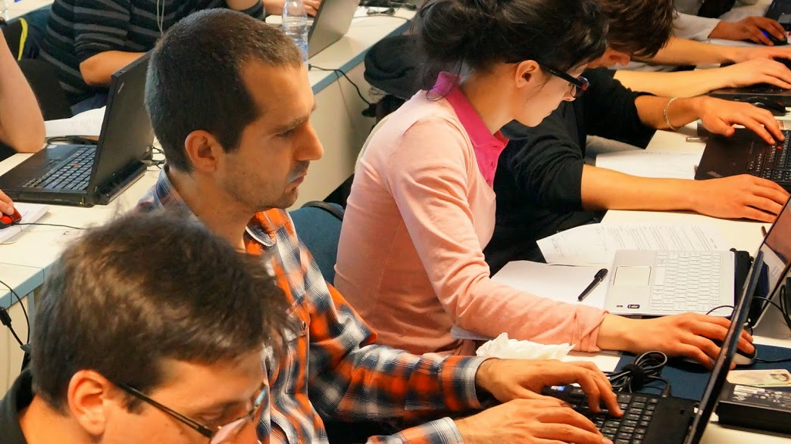
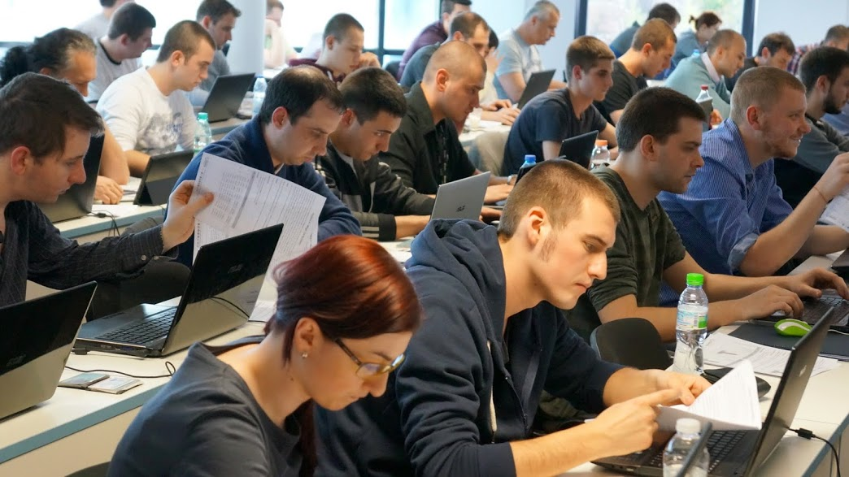

Data Structures
Evaluation Criteria

Slide 19
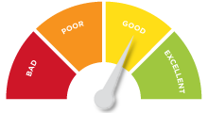

Scoring System for the "Data Structures"
Practical exam
90%
Homework + evaluation
5% + 5%
Contribution in the forum:
up to 10% bonus

Slide 20


Data Structures – Practical Exam
The practical exam tests your skills to design, implement and use data structures efficiently
2 problems for 6 hours
Command execution system
E.g. add + edit + remove tickets + search
E.g. add + extract-min + extract-max
Automated judge system with real-time feedback: http://judge.softuni.bg

Slide 21

Homework Assignments
Doing your homework is very important!
Programming can only be learned through a lot of practice!
You should write code every day!
Each lecture is followed by a few exercises
Try to solve them in class
The rest are your homework
Homework assignments are due in 1-2 weeks after each lecture
Submission will be accepted through our web site: softuni.bg

Slide 22


Homework Peer Reviews
Give feedback to a few random homework submissions
Students submit homework anonymously
Please exclude your name from the submissions!
For each homework submitted
Students evaluate 3 random homeworks
From the same topic, after the deadline
Give written feedback, at least 200 characters
Low-quality feedback → report for punishment
Everyone will get feedback for their homework

Slide 23









Resources
What We Need Additionally?

Slide 24

Course Web Site & Forums
The Data Structures course official Web site:
Register for the "Software University Forum":
Discuss the course exercises with your colleagues
Find solutions for all course exercises and labs
Share source code / discuss ideas / help each other
https://softuni.bg/trainings/1147/Data-Structures-June-2015
https://softuni.bg/forum

Slide 25



Data Structures Slides and Videos
All lecture slides, videos, homework assignments, labs and other resources are open content, available for free
Visit the course web site to access the course resources

Slide 26

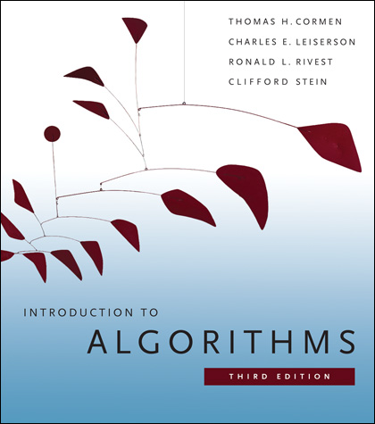
Data Structures – Additional Resources
Nakov P., Dobrikov P., "Programming = ++ Algorithms;", 5th Edition, ISBN: 954-8905-06-X, Faber Publishing (2015)
Download a free copy from: www.programirane.org
No English version (Bulgarian only)
Cormen T., Leiserson C., Rivest R., Stein C., "Introduction to Algorithms", 3rd Edition, ISBN 978-0262033848, MIT Press (2009)
Find the book in Internet: https://goo.gl/ElgQD3

Slide 27
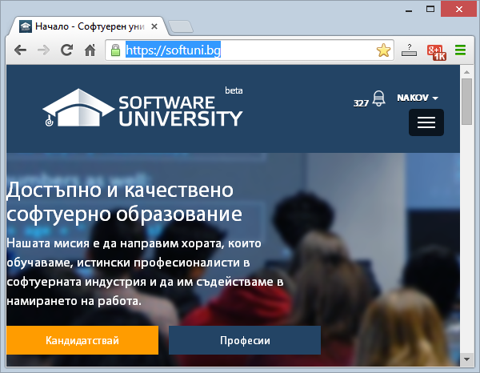
Software University Learning System (SULS)
Software University Learning System (SULS)
www.softuni.bg
Important resources for students
Homework submissions
Homework check-up
Exams and results
Discussion forum
Reports about your progress

Slide 28
Recommended Software
Visual Studio Community 2013
Or other C# development environment
SharpDevelop – lightweight IDE for C#
Xamarin Studio – powerful IDE for C# / .NET for Linux, Mac OS X, Windows and others
Wintellect Power Collections
https://powercollections.codeplex.com
Eclipse / IntelliJ IDEA (for Java), Code::Blocks (for C++)

Slide 29









Data Structures
https://softuni.bg/trainings/1147/Data-Structures-June-2015

Slide 30
License
This course (slides, examples, labs, videos, homework, etc.) is licensed under the "Creative Commons Attribution-NonCommercial-ShareAlike 4.0 International" license
Attribution: this work may contain portions from
"Fundamentals of Computer Programming with C#" book by Svetlin Nakov & Co. under CC-BY-SA license
"Data Structures and Algorithms" course by Telerik Academy under CC-BY-NC-SA license

Slide 31





Free Trainings @ Software University
Software University Foundation – softuni.org
Software University – High-Quality Education, Profession and Job for Software Developers
softuni.bg
Software University @ Facebook
facebook.com/SoftwareUniversity
Software University @ YouTube
youtube.com/SoftwareUniversity
Software University Forums – forum.softuni.bg

